Slide 1
DEVICE TRACKING AND INVENTORY MANAGEMENT SYSTEM
Team Member’s:-
1. Marisha Talreja (70) (D12A)
2. Disha Rajani(58)(D12B)
3. Rahul Lalchandani(35))(D12C)
4. Nikhil Tilwani (65)(D12C)
Mentor Name:-
Prof Prashant Kanade

Slide 2
PROBLEM STATEMENT
To design a system which can track and store the devices ( like Printer , Scanner , Monitor , CPU , etc ) using RF Technology and other various components which will help the user to find the device very easily and quickly.

Slide 3
NEED OF SYSTEM
Tracking and security are an essential part
Labs Deals with lot of Expensive Equipments
Monitoring of laboratory equipments is performed manually by the lab administrator
A log book needs to be filled up in order to keep track the equipment information.
Some of weaknesses such as
misuse of the equipment log records
no in-out transaction record
misplace of equipments
time consuming

Slide 4
IMPLEMENTATION OF SYSTEM
makes use of the RFID technology
one of the most practical and applicable in real time implementation
nature where most of the systems are made computerized.
Much more labor efficient.
once set up, an RFID system can be run with minimal human participation

Slide 5
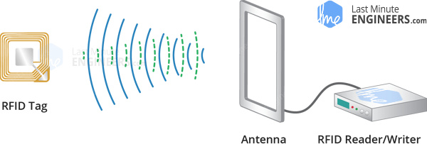
What is RFID(Radio Frequency Identification) Technology
Consists of two main components,
Tag attached to an object to be identified
Transceiver also known as Reader.

Slide 6
What is RFID(Radio Frequency Identification) Technology
Reader consists of a Radio Frequency module
antenna generates high frequency electromagnetic field.
The RFID tag is a passive device, i.e doesn’t contain a battery.
contains microchip that stores and processes information, and antenna to receive and transmit a signal.
To read the information encoded on a tag, it is placed in close proximity to the Reader
Reader generates an electromagnetic field which causes electrons to move through the tag’s antenna and subsequently power the chip.

Slide 7
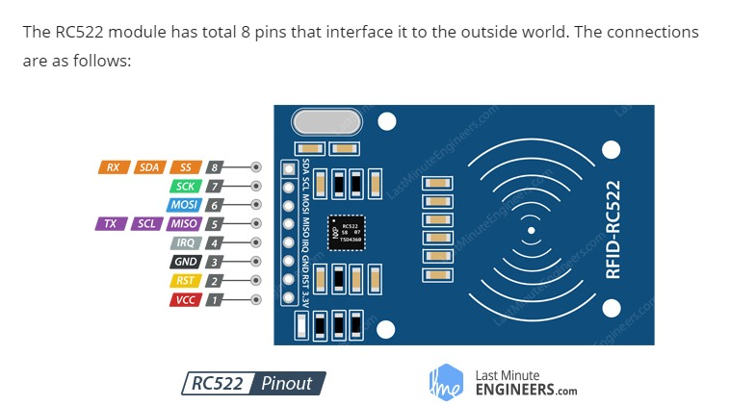

Slide 8
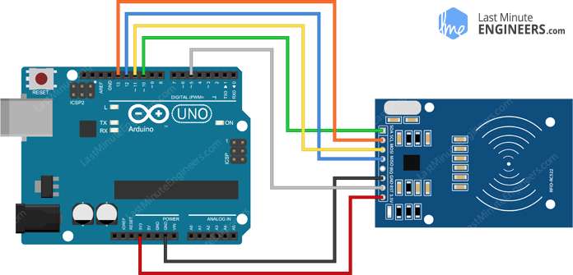
Wiring RC522 RFID Reader Writer Module with Arduino UNO

Slide 9
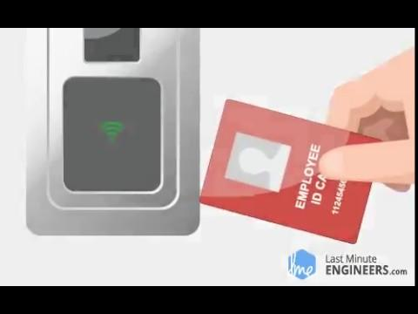

Slide 10
DATABASE ARCHITECTURE
Devices Lab
Master Device
Log
DeviceId | Description
LabId | Description
DeviceId | LabId | Status(in/out) | CurrentLab
Device | CurrentLab | Status | TimeStamp

Slide 11
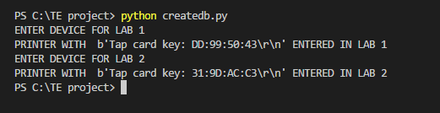
Outputs

Slide 12
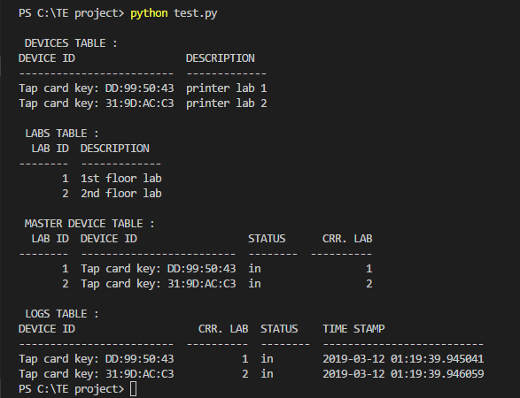

Slide 13
CONCLUSION
DeviceTracking and Invertory Mangement System using RFID is proposed to effectively monitor the in-out equipment from the laboratory. Via this system, every activity can be monitored and updated in real time. The adaptation of RFID-based Device tracking System also would promote diversity which previously are handled manually.

Slide 14
FUTURE SCOPE
Adding GUI
Separate Login for admin and lab assistant
Backing of data in cloud

